Slide 1

Discriminator for Docking structures using Targets predicted by AlphaFold
2022.05.24
발표자 : 배병현

Slide 2
목차
1. Background & Research objective
2. Entire Process 3. Proceeded things

Slide 3
1. Background & Research objective

Slide 4
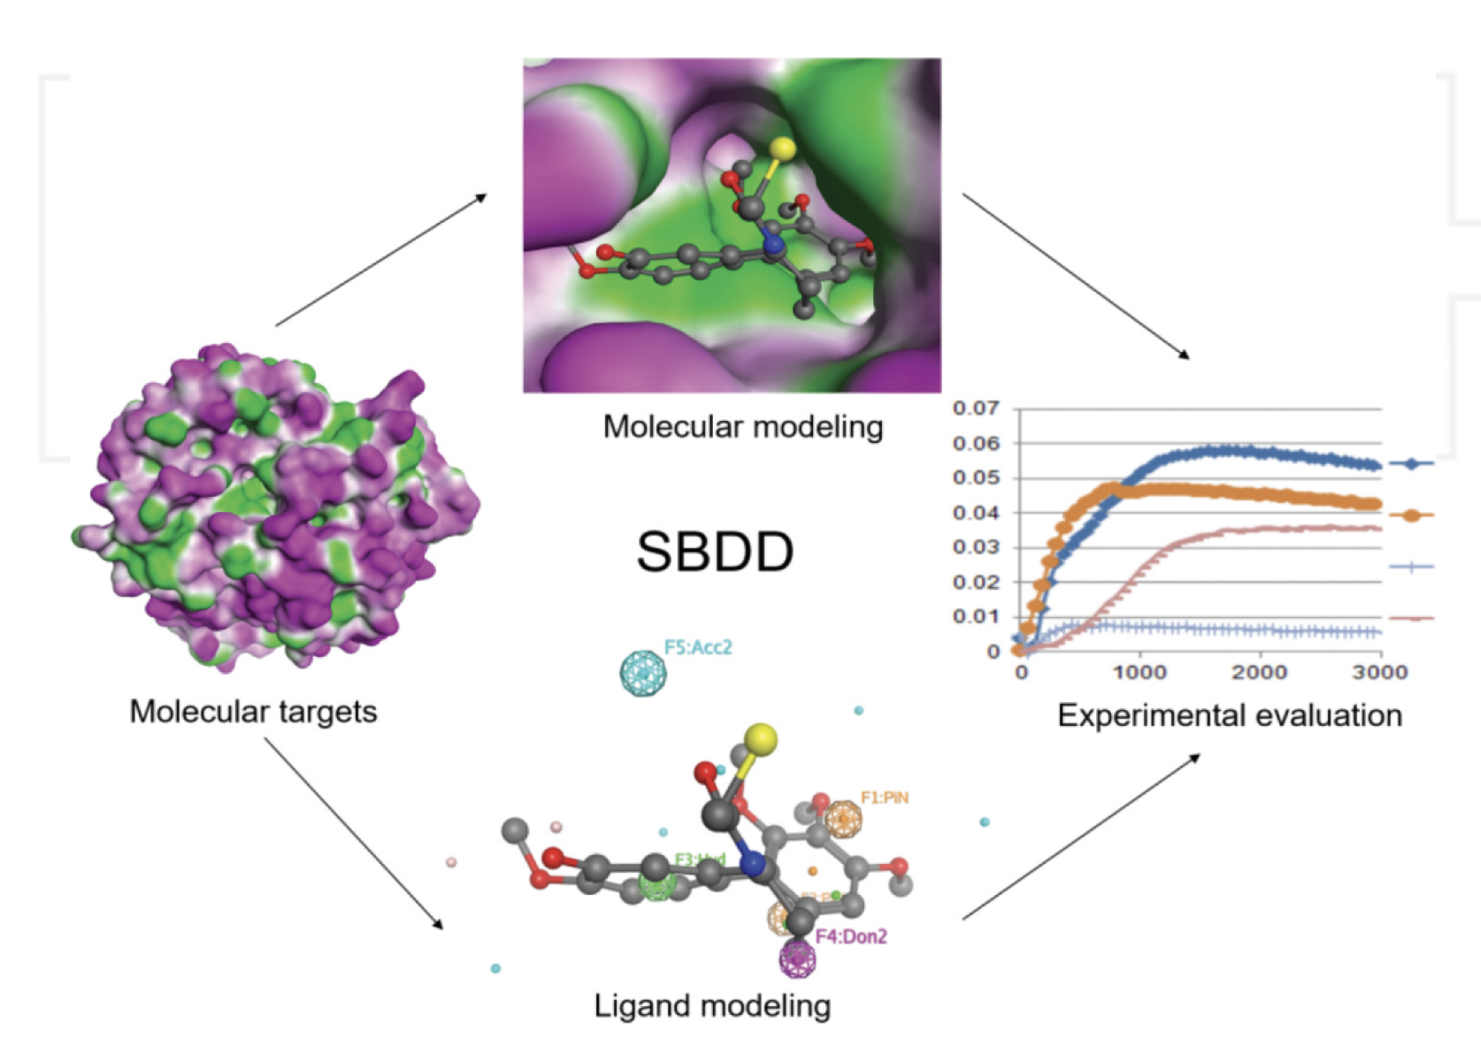
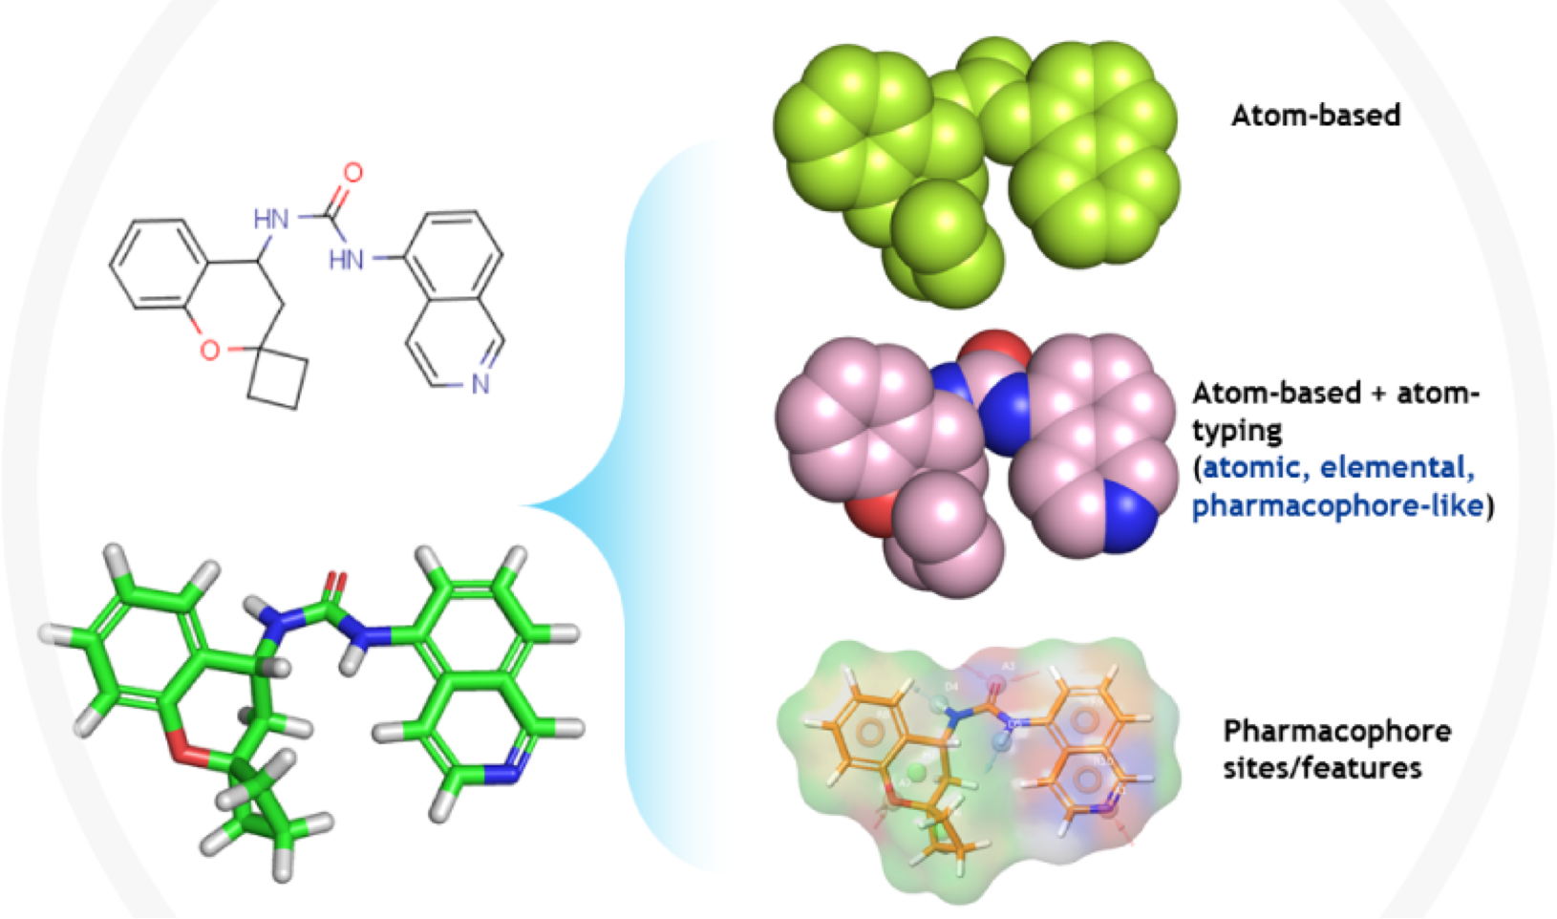
1. Background & Research objective
1-1. Background
Structure-based drug design
Ligand-based drug design
The design and optimization of a chemical structure with the goal of identifying a compound suitable for clinical testing — a drug candidate
The approach used in the absence of the receptor 3D information and it relies on knowledge of molecules that bind to the biological target of interest
https://www.jubilantbiosys.com/services/ligand-based-drug-discovery/
Lo, Ben & Gui, Ren & Honda, Hiroshi & Torres, Jorge. (2016). Quantitative Methods in System-Based Drug Discovery. 10.5772/65833.

Slide 5
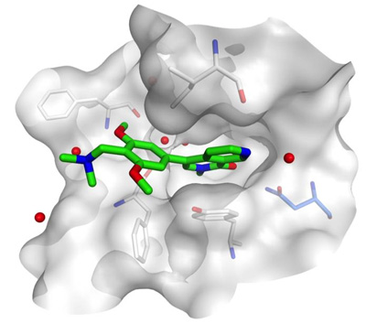
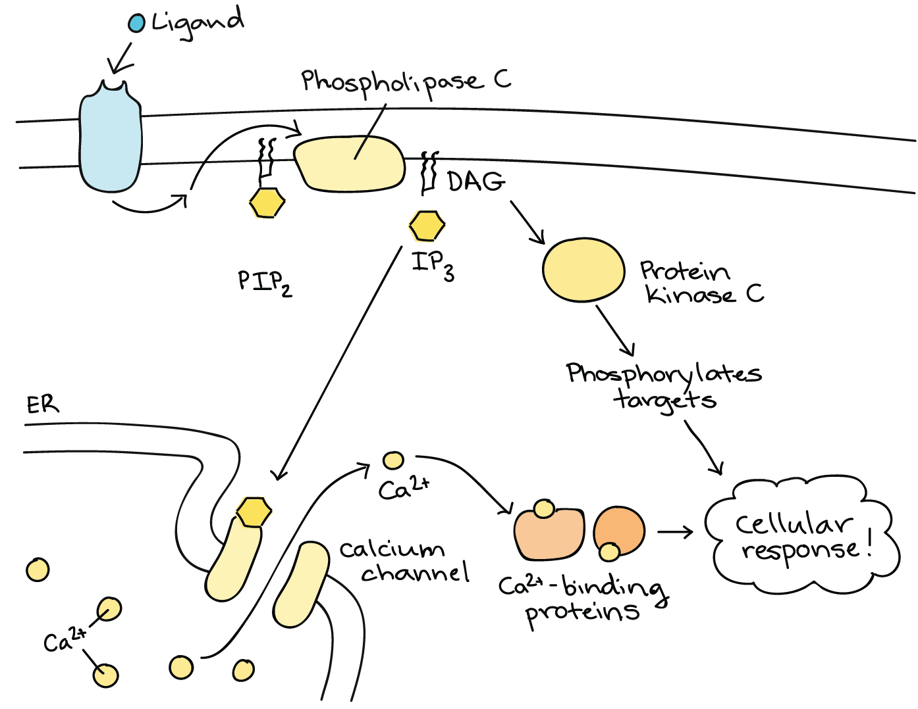
1. Background & Research objective
Target
https://www.khanacademy.org/science/ap-biology/cell-communication-and-cell-cycle/changes-in-signal-transduction-pathways/a/intracellular-signal-transduction

Slide 6
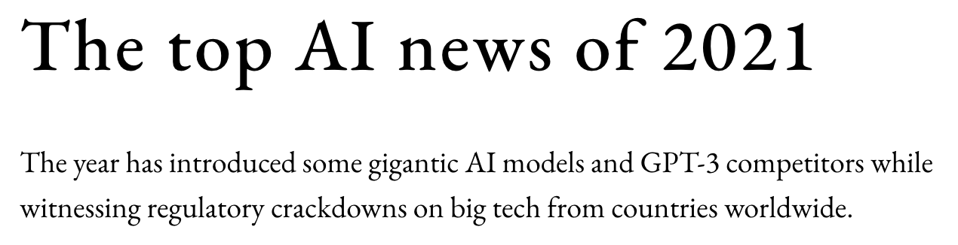
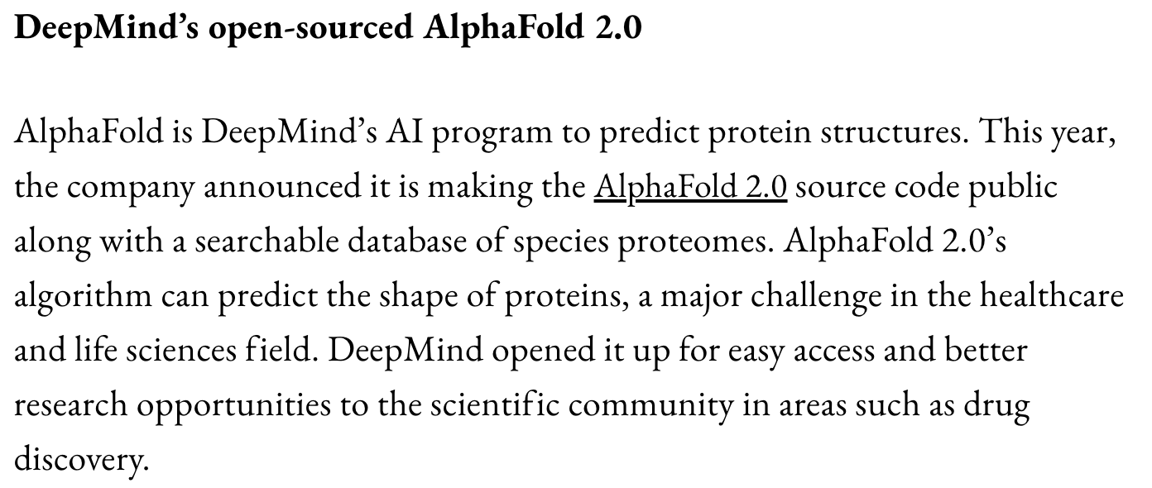
1. Background & Research objective
1-1. Background
AlphaFold

Slide 7
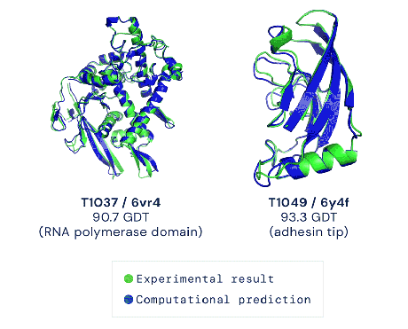
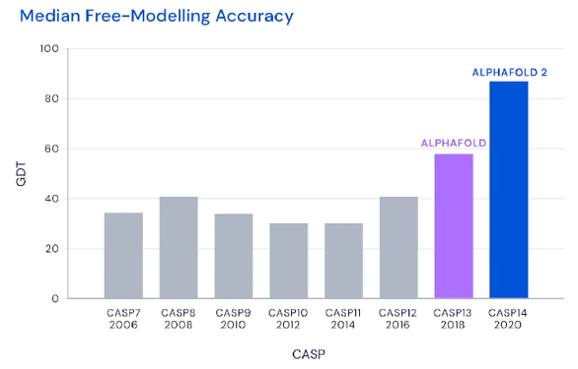
1. Background & Research objective
1-1. Background
AlphaFold
AI for protein structure prediction developed by Deepmind
Inputs to the network are the primary sequence, sequences from evolutionarily related proteins in the form of a MSA and 3D atom coordinates of a small number of homologous structures (templates) where available.

Slide 8
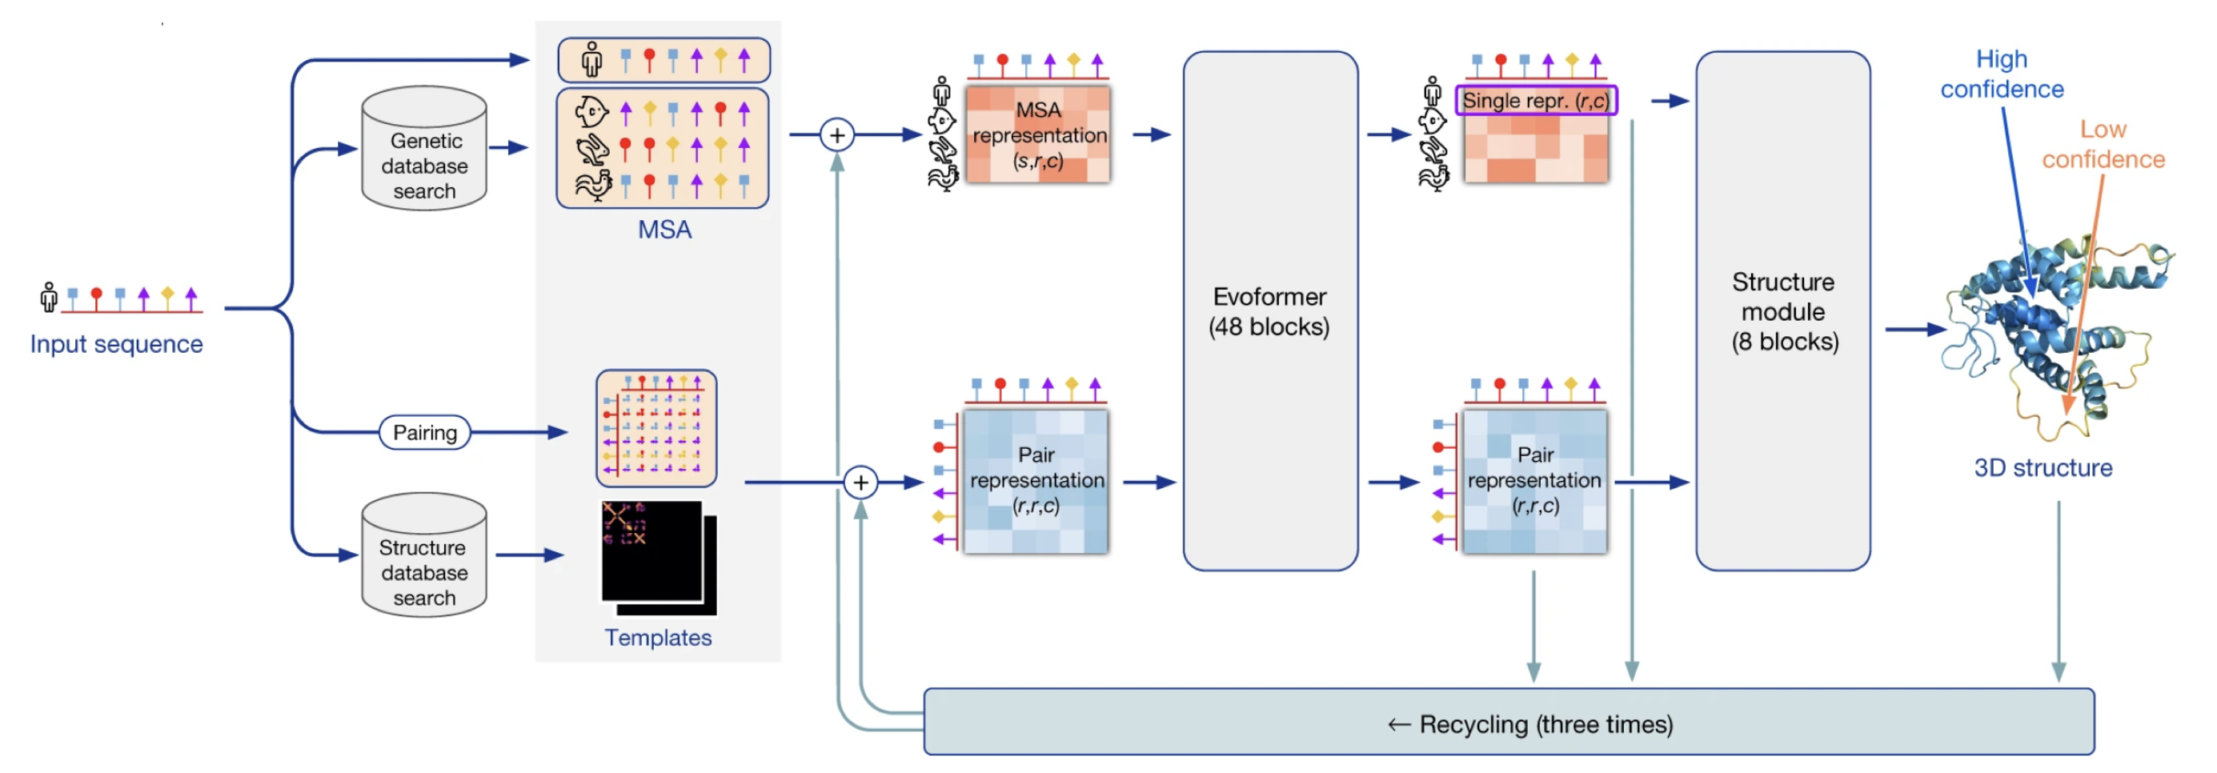
1. Background & Research objective
1-1. Background
AlphaFold
Jumper, John, et al. "Highly accurate protein structure prediction with AlphaFold." Nature 596.7873 (2021): 583-589.

Slide 9
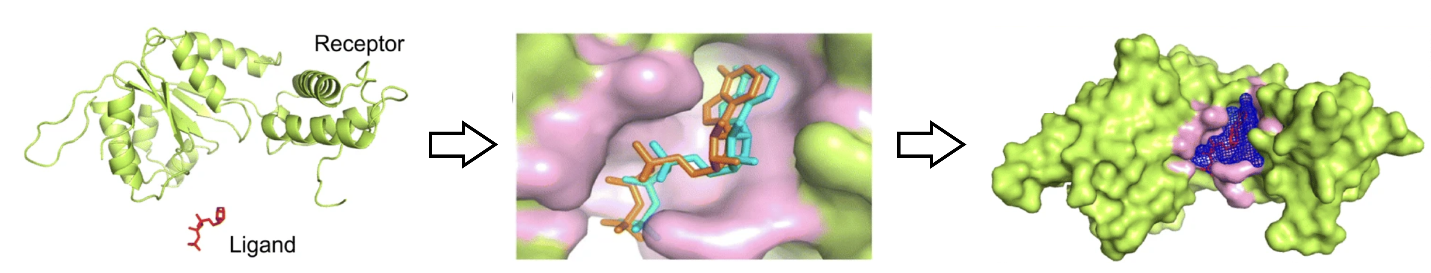
1. Background & Research objective
1-1. Background
Protein-ligand docking
The molecular modeling technique to predict ligand–protein binding conformations
It can be used to help identify drug-like leads through virtual screening
Zhang, Wenyi, et al. "EDock: blind protein–ligand docking by replica-exchange monte carlo simulation." Journal of cheminformatics 12.1 (2020): 1-17.

Slide 10

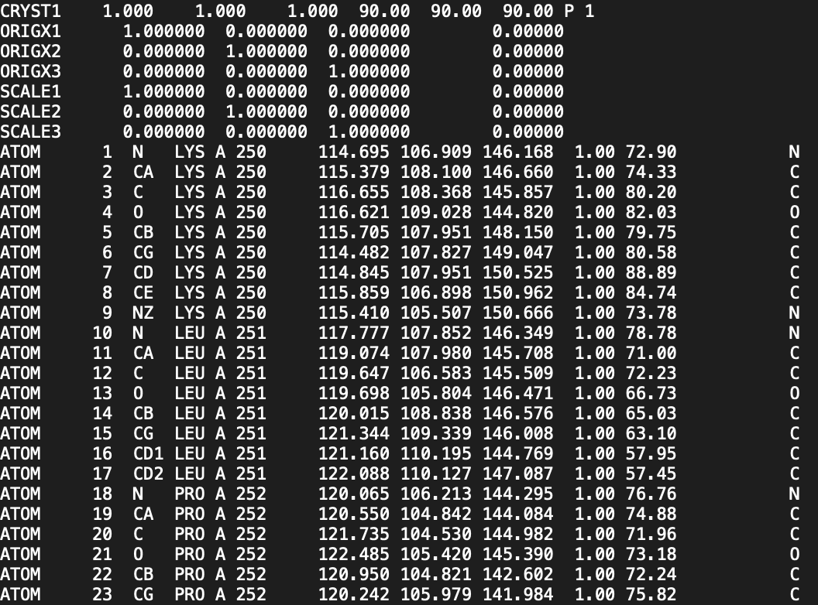
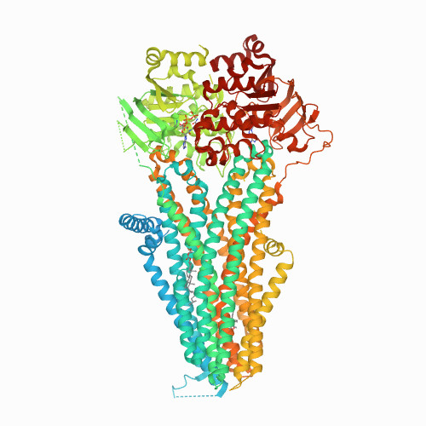

1. Background & Research objective
1-1. Background
PDB (Protein Data Bank)
Database for the three-dimensional structural data of large biological molecules, such as proteins and nucleic acids.

Slide 11
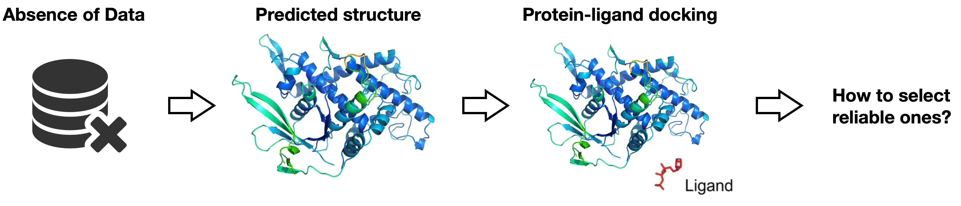
1. Background & Research objective
1-2. Research Objective
In the absence of experimental protein structures (X-ray crystallography), Structures predicted by AI (AlphaFold) can be used.
Object
1. Increase probability that actual structure is in the set when select multiple docking results.
2. Quantify the reliability of results that initiated from predicted protein structures as model’s output.
Zhang, Wenyi, et al. "EDock: blind protein–ligand docking by replica-exchange monte carlo simulation." Journal of cheminformatics 12.1 (2020): 1-17.

Slide 12
2. Entire Process

Slide 13
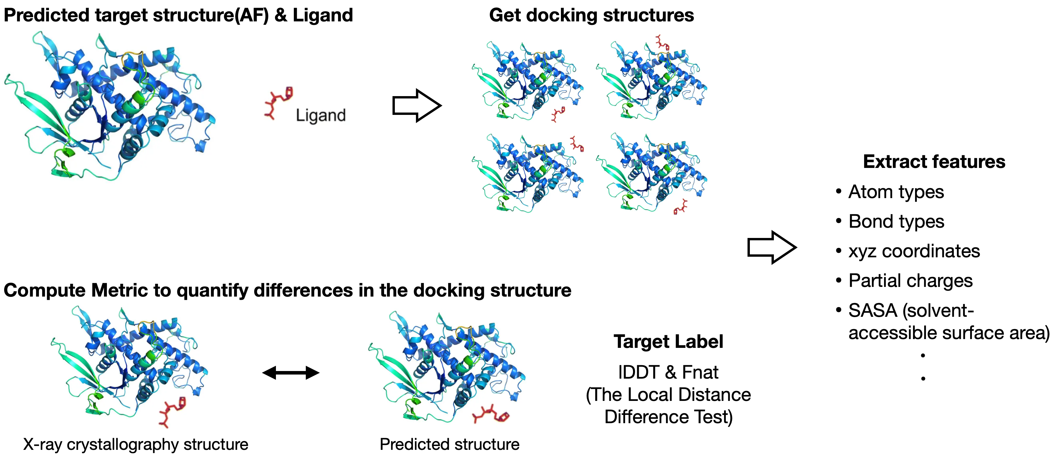
1. Background & Research objective
2-1. Summary of entire process

Slide 14
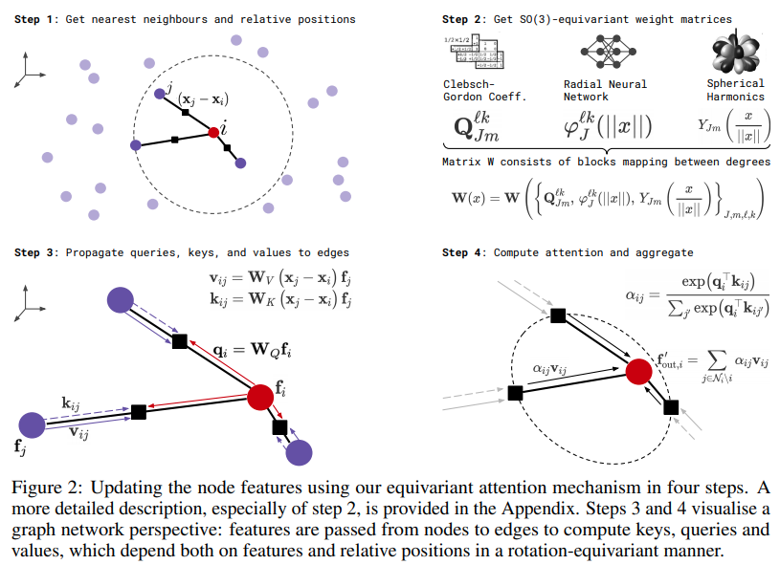
1. Background & Research objective
2-1. Summary of entire process
Model: SE(3) Transformer
3D Roto-Translation Equivariant Attention Networks

Slide 15
1. Background & Research objective
2-2. Datasets
Train data
Total 4,683 PDB files (target structures), but 4,620 structures are used
70~100 docking files for each target structure (PDB)
Validation data
Total 1,297 PDB files (target structures), but 1,290 structures are used
70~100 docking files for each target structure (PDB)
Test data
Total 208 PDB files (target structures)
240~260 docking files for each target structure (PDB)

Slide 16
3. Proceeded things

Slide 17
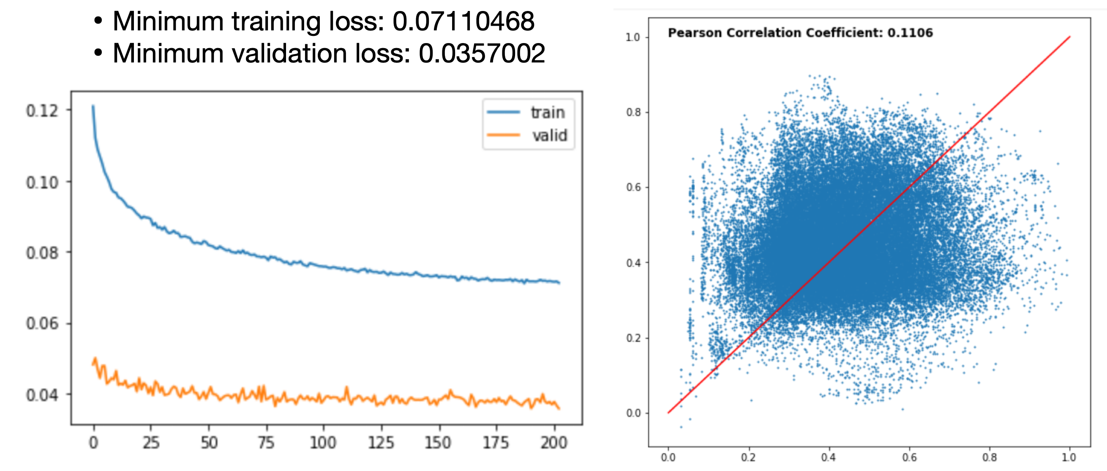
1. Background & Research objective
3. Proceeded things
Models with Training loss

Slide 18
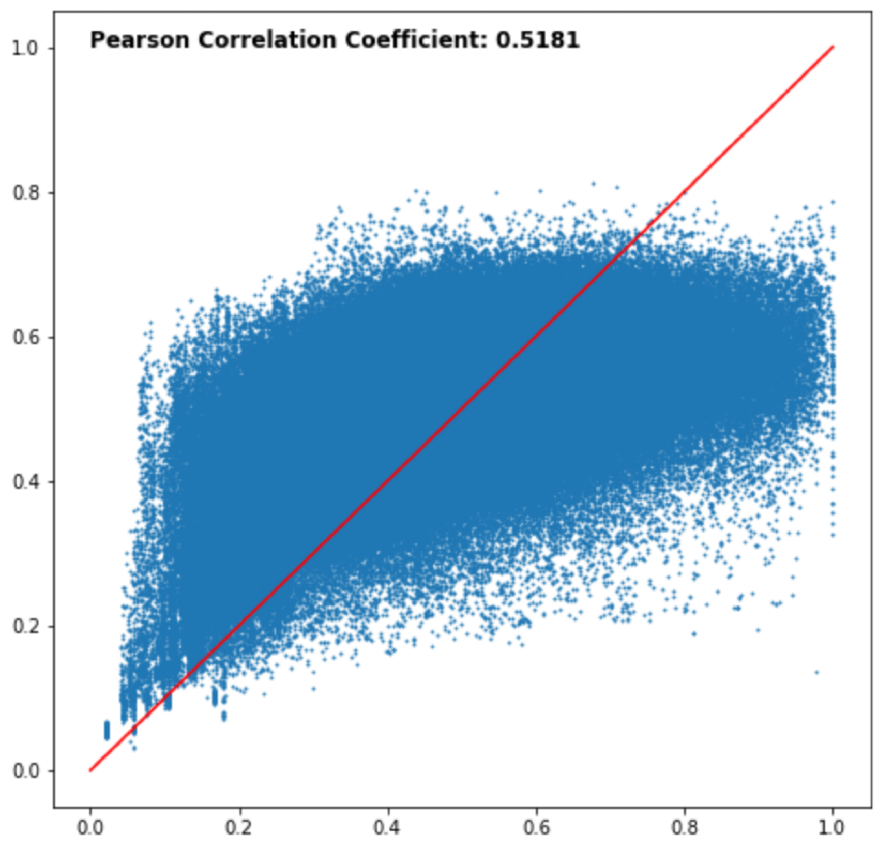
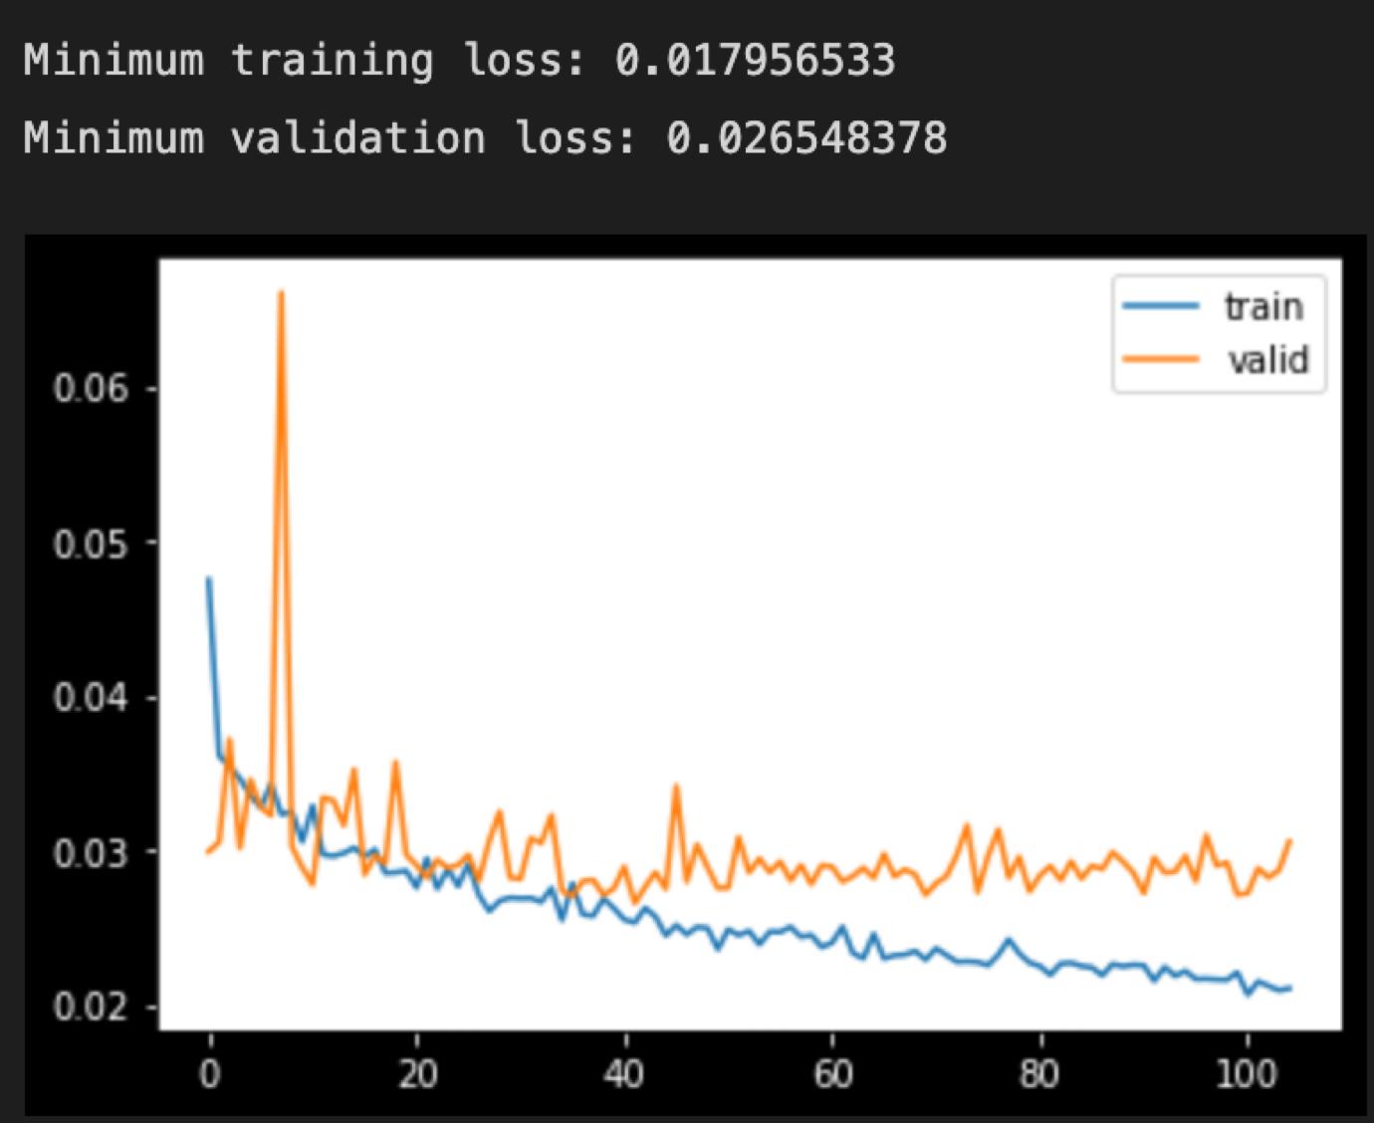
1. Background & Research objective
3. Proceeded things
Models with Training loss

Slide 19
Reference
Fuchs, Fabian, et al. "Se (3)-transformers: 3d roto-translation equivariant attention networks." Advances in Neural Information Processing Systems 33 (2020): 1970-1981.
Notes:
네 이상, 발표를 마치겠습니다. 감사합니다.

Slide 20
THANK YOU
FOR YOUR
ATTENTION
Notes:
네 이상, 발표를 마치겠습니다. 감사합니다.

